Slide 1


CLINICAL TEACHING TRAINING
2026-2027

Slide 2
CLINICAL TEACHING TRAINING
Today’s training focuses on three areas that will help you succeed in clinical teaching.
01
Clinical Teaching
Your Role, Requirements, Observations, & Documentation.
02
Professional Conduct
Ethics, Communication, Confidentiality, & Professional Boundaries.
03
Reflective Practice
Receiving Feedback, Reflection, Goal-Setting, & Growth.
Together, these areas describe what is expected of you and what you can expect from your Clinical Teaching team.

Slide 3
TEACHER CANDIDATE
A student formally admitted to the proposed WC EPP who completes clinical teaching in the classroom of a Cooperating Teacher to demonstrate proficiency in the educator standards

Slide 4

01
CLINICAL TEACHING
Your Role, Requirements, Observations, & Documentation

Slide 5
Clinical Teaching is one supervised assignment across two consecutive semesters and totaling at least 490 hours.
Candidates move from guided practice to increasing instructional responsibility via planning, teaching, assessment, classroom management, and professional collaboration.

Slide 6
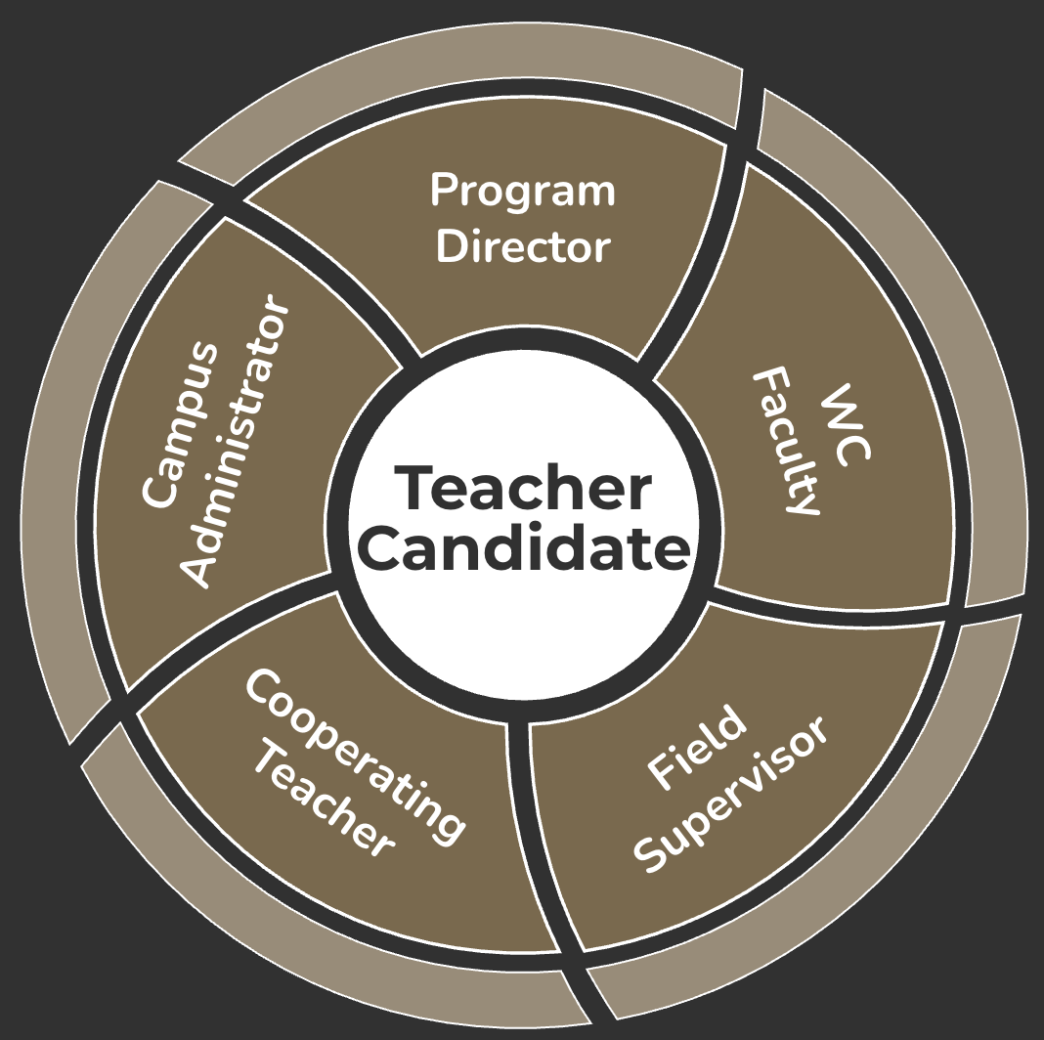
CANDIDATE
SUPPORT TEAM
Provides oversight of the educator preparation program, monitors Candidate progression, and ensures compliance with state and institutional requirements.
Supports Candidate access by helping ensure an appropriate school setting, site access, and a professional learning environment.
Delivers coursework and performance-based preparation that support Candidate development, field application, and certification readiness.
Clinical Teaching Cooperating Teachers: provide daily modeling, guidance, and feedback during the clinical teaching assignment. Collaborate with Field Supervisor to support Candidate growth and readiness for certification.
Provides supervision during clinical teaching through formal and informal observations, coaching, feedback, and collaboration with the clinical teaching Cooperating Teacher.
In-Service
Teachers

Slide 7
CLINICAL TEACHING
ASSIGNMENT BY THE NUMBERS
28
490+
245+
280+
Weeks across consecutive semesters
Total verified Clinical Teaching hours
Hours in each 14-week half-day phase
Hours in the certification subject & grade level
Complete the WC field placement application & all requested district clearance steps.
START-OF-SCHOOL-YEAR EXPERIENCE
Each Candidate participates in the first 15 instructional days of a school year during one course phase.
Only the WC EPP may review, approve, and document any permitted reduction in required hours.

Slide 8
CLINICAL TEACHING
One assignment across two semesters
Minimum Aligned hours
At least 280 hours must occur in the subject area and grade level of the certificate sought under the Cooperating Teacher’s supervision.
Increasing Responsibility
Candidates progress through co-teaching, instruction, assessment, classroom management, and other professional responsibilities.
Attendance & Documentation
Candidates maintain a consistent half-day schedule, complete the full required hours, and submit verified records.
Completion Decision
Successful clinical teaching requires demonstrated proficiency plus the required recommendations and final program verification.
490+ TOTAL HOURS | 245+ HOURS CLINICAL TEACHING I | 245+ HOURS CLINICAL TEACHING II

Slide 9
CLINICAL TEACHING
Start of School Year Requirement
FIRST 15 INSTRUCTIONAL DAYS
All Candidates experience the start of the school year during a fall semester of their two-semester clinical teaching assignment.
SPRING GRADUATES
Complete in May
FALL SEMESTER
Clinical Teaching I
First half of assignment includes the first 15 instructional days
SPRING SEMESTER
Clinical Teaching II
Second half of assignment and program completion
FALL GRADUATES
Complete in December
SPRING SEMESTER
Clinical Teaching I
First half of assignment
FALL SEMESTER
Clinical Teaching II
Second half of assignment includes the first 15 instructional days and program completion

Slide 10

ELIGIBILITY & PLACEMENT
Before Clinical Teaching, you must…
PRESERVICE MINIMUMS
Complete at least 50 clock-hours of Field-based experiences (25+ in K-2, 25+ in Grades 3-6).
50+ FBE hrs
+
150+
course hrs
Complete at least 150 clock-hours of coursework in the required pedagogical skills.
Clear the district criminal background check before each semester.
Placement is assigned by the proposed WC EPP with the campus. You may not arrange or change it yourself.
Not be placed with a relative or with anyone you supervise.
Obtain professional liability insurance before the first day (strongly recommended).
Report a qualifying leave (parental, military, medical, bereavement) to your Field Supervisor and the Program Director at once; only the proposed WC EPP may approve a reduction, never below 455 hours.

Slide 11
GRADUAL RELEASE OF RESPONSIBILITY
The stages describe a developmental progression, not a prescribed calendar.
1
Orientation & Observation
2
Assisted Instruction & Co-Teaching
3
Increasing Lead Instruction
Learn routines, students, curriculum, & context.
4
Sustained Lead Instruction
Lead components & groups with immediate support.
5
Transition & Reflection
Plan & lead lessons or content blocks.
Lead a substantial portion with ongoing oversight.
Demonstrate consistency & prepare for second semester or entry-year teaching.
Progress may accelerate, slow, pause or temporarily reverse. Readiness, not the calendar, drives release. Raise pacing concerns with your Cooperating Teacher first, then your Field Supervisor.
(Fisher & Fry, 2014)

Slide 12
CO-TEACHING MODELS
SHARED WORK
Plan
Teach
Assess
Reflect
Choose the approach by the objective, content, student need, & classroom context.
TEACH & OBSERVE
TEACH & ASSIST
One leads while one collects evidence.
One leads while one supports individuals or groups.
STATION TEACHING
PARALLEL TEACHING
Both lead different stations as students rotate.
Both teach the same or related content to groups.
ALTERNATIVE TEACHING
TEAM TEACHING
One leads larger group while one targets smaller group.
Both share active delivery throughout the lesson.
Before Instruction: Name who leads, who monitors, and how support will be provided.
(Friend & Cook, 2017)

Slide 13
LESSON-PLANNING PROGRESSION
Beginning in Week 3, the Candidate submits plans for instruction they are responsible for delivering.
WEEKS 1-2
0
Required Plans
WEEKS 3-4
1
Required Plans
WEEKS 5-6
2
Required Plans
WEEKS 7-11
4
Required Plans
WEEKS 12-14
2
Required Plans
ORIENTATION & OBSERVATION
INITIAL TEACHING & CO-TEACHING
EXPANDING RESPONSIBILITIES
INCREASING INSTRUCTIONAL LEADERSHIP
TRANSITION & REFLECTION
Submit each required plan, initialed by your Cooperating Teacher, before you teach it. Use the full Lesson Plan for every formally observed lesson. A plan without initials is incomplete.
YOUR ROLE

Slide 14
FIELD SUPERVISION
Progression is dependent upon meeting published performance and disposition expectations.
Formal Observations
WC conducts all four in person; each includes preconference, 45+ minute observation, written feedback, and post conference. First formal observation must occur during the first 3rd of the entire clinical teaching assignment.
2 in EDEL 4311 (1st half)
2 in EDEL 4312 (2nd half)
Each lasts 15+ minutes. The first each semester occurs in person within the first six weeks. All informal observations are done in person.
Informal Observations
6 total, 3/semester
The Field Supervisor collaborates with the Candidate and Cooperating Teacher throughout the assignment via Supervision Schedule, Weekly Candidate reflections, Cooperating Teacher Checkpoints, and evaluations..
Cooperating Teacher
Feedback
AT LEAST 3 documented requests
Candidates must meet the program’s published performance disposition expectations to progress and complete. Cooperating Teacher and Field Supervisor collaborate to complete each evaluation determining whether a candidate continues from EDEL 4311 to EDEL 4312 or is recommended for certification.
Evaluations
Midpoint → Final
PROGRAM NOTICE: The observation schedule shown reflects current Texas Administrative Code and proposed WC EPP requirements for the candidate’s approved clinical teaching assignment. WC may adjust observation timing or require additional observations when necessary to maintain compliance, address a change in assignment structure, or provide documented candidate support. Completion of the minimum observation schedule does not, by itself, establish successful clinical teaching.

Slide 15
CLINICAL TEACHING
Observation cycle: what to expect
Pre-Observation Conference
The week before each formal observation. Bring your initialed Lesson Plan, your materials, and the student data you used. Name the T-TESS dimensions you want feedback on.
Observation (45+ minutes)
Teach the lesson you planned for at least 45 continuous minutes. Your Field Supervisor records evidence and will not interrupt or co-teach. Your Cooperating Teacher remains responsible for the room.
Post-Observation Conference
Within one week. You reflect first, then review the evidence dimension by dimension and agree on one or two next steps with a follow-up date. Signing acknowledges receipt, not agreement.
Ratings
WC EPP Clinical Teaching Rating Scale: Accomplished, Proficient, Developing, Improvement Needed (Not Observed when evidence is unavailable). Based only on evidence from the observation. Informal observations are not rated.
3 INFORMAL (15+ MIN) AND 2 FORMAL (45+ MIN) OBSERVATIONS PER COURSE | ALL IN PERSON

Slide 16
CLINICAL TEACHING
Your documentation, every week
Timesheet
Record arrival, departure, and activity codes daily. Obtain Cooperating Teacher initials weekly and signatures on the semester record in Week 14. Make-up hours go on the date completed.
Weekly Reflection
Five to seven sentences minimum on your instruction and student learning, plus your Cooperating Teacher’s glows, grows, suggestions, and signature.
Lesson Plans
Weekly plans from Week 3 (1, 2, 4, then 2 per week), each initialed before instruction. Full Lesson Plan for every formal observation.
Never falsify
Hours you did not work or lessons you did not teach may never be recorded. Falsifying records violates the Code of Ethics and is grounds for removal and dismissal. Report any error to your Field Supervisor at once.
SUPERVISION SCHEDULE BY WEEK 2 | HANDBOOK & CODE OF ETHICS ACKNOWLEDGMENT BEFORE DAY 1 | ALL RECORDS VIA CANVAS

Slide 17
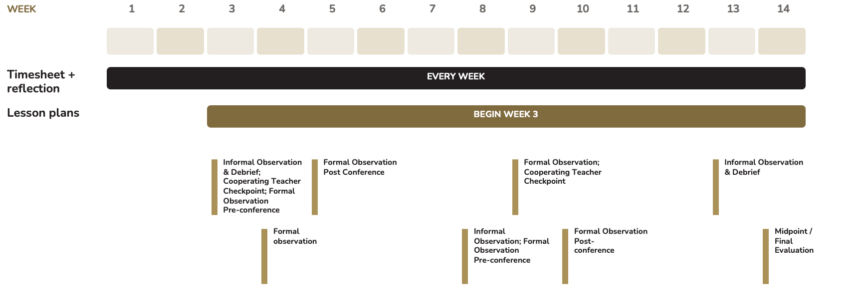
SUPERVISION SCHEDULE
The same schedule applies in EDEL 4311 and EDEL 4312 unless the proposed WC EPP communicates otherwise.
CANDIDATE: Complete and submit every record on time. Record only hours you actually worked, and never ask anyone to sign an incomplete or inaccurate record.

Slide 18
OBSERVATION & EVALUATION ROLES
FIELD SUPERVISOR
YOUR RESPONSIBILITIES
3
Informal Observations of 15+ minutes per semester
Prepare a full, initialed Lesson Plan for each formal observation.
Bring your written reflection to every conference.
2
Formal Observations of 45+ minutes per semester
Participate in Feedback Checkpoint debriefs in Weeks 3 & 9.
Sign evaluations to acknowledge receipt (not agreement).
Provides written feedback to the Candidate & Cooperating Teacher.
Apply feedback and report back on your next step.
Formal and Informal Observations and Cooperating Teacher Feedback Checkpoint are separate documents with separate purposes.

Slide 19
SUCCESSFUL COMPLETION
HOURS ARE NECESSARY
but hours alone do not equal successful completion.
Both recommendations are earned through your documented daily performance.
The Candidate must…
Complete AT LEAST 490 verified hours.
Demonstrate proficiency in applicable educator standards.
Complete observations, evaluations, coursework, & documentation.
Earn “Developing”+ in every T-TESS domain on Final Evaluation.
Meet professionalism and ethical conduct expectations.
Receive recommendations from both the Cooperating Teacher & Field Supervisor.

Slide 20

02
PROFESSIONAL CONDUCT
Ethics, Communication, Confidentiality, & Professional Boundaries

Slide 21
PROFESSIONAL EXPECTATIONS
ATTENDANCE
Arrive 10–15 minutes early. Notify your Cooperating Teacher and Field Supervisor of absences in advance. Make up missed hours.
1
COMMUNICATION
Use professional channels, respond within 24 hours, and communicate schedule changes promptly.
2
3
PRIVACY
Do not post classroom, student, school, or placement information. Ask before photographing approved materials.
4
BOUNDARIES
Keep relationships & digital communication professional. Use school or institution-approved channels.
PROFESSIONALISM
Follow campus expectations for dress, conduct, preparation, and use of non-instructional time.
5
Never serve as the sole adult or a substitute teacher, even briefly. Never transport students. If asked, decline and tell your Field Supervisor the same day.

Slide 22
Tiered Accountability Process
As a professional preparation program, we are committed to our teacher candidates’ growth. The tiered accountability process helps us support candidates who encounter challenges while maintaining the integrity of the teaching profession.

Slide 23
TIERED ACCOUNTABILITY PROCESS
As a professional preparation program, we are committed to our teacher candidates’ growth. The tiered accountability process helps us support candidates who encounter challenges while maintaining the integrity of the teaching profession.
Step 3: Dismissal
Step 2: Probation
Step 1:
Growth Plan

Slide 24
TIERED ACCOUNTABILITY PROCESS
Step 1: Growth Plan
When early concerns such as absences, missed work, or professionalism arise, the candidate meets with the Director to develop and sign a Growth Plan. This plan outlines goals, supports, timelines, and success criteria. If expectations are not met, the candidate progresses to Probation.
Step 3: Dismissal
Step 2: Probation
Step 1:
Growth Plan

Slide 25
TIERED ACCOUNTABILITY PROCESS
Step 2: Probation
If Growth Plan goals are not met or serious concerns arise, the candidate is placed on Probation. They remain enrolled but are not in good standing. Probation may include restricted placements, increased supervision, or mandatory professional development. To avoid dismissal, the candidate must meet all written expectations.
Step 3: Dismissal
Step 2: Probation
Step 1:
Growth Plan

Slide 26
TIERED ACCOUNTABILITY PROCESS
Step 3: Dismissal
The candidate is formally dismissed from the proposed WC EPP/ certification pathway. This includes removal from fieldwork, clinical teaching, and certification recommendation eligibility. Degree-only continuation, if applicable, is determined under BAAS ECET and College policy.
Step 3: Dismissal
Step 2: Probation
Step 1:
Growth Plan

Slide 27
WHEN CONCERNS ARISE
IMMEDIATE RISK
PERFORMANCE OR PROFESSIONAL CONCERN
Student safety, well-being, or learning is at risk.
Alert your Cooperating Teacher or the nearest staff member.
Follow campus or district procedures.
Tell your Field Supervisor as soon as practicable.
Attendance ⏺ Preparation ⏺ Conduct
Performance ⏺ Documentation
Coaches describe observable facts.
You receive clear feedback and a next step.
Apply the feedback and report back.
Ask questions early, not at the evaluation.
Your Cooperating Teacher and Field Supervisor report concerns when they arise, not at the evaluation. The proposed WC EPP determines whether a Growth Plan, Probation, Removal, or Dismissal is appropriate.

Slide 28
Complaints and Grievance Procedures
STEP 1
Direct Communication
STEP 2
Submit a Formal Complaint
STEP 3
Request Review from Dean
STEP 4
Institutional Appeal
STEP 5
File Complaint with TEA
Step 1: Direct Communication
The candidate begins by speaking directly with the individual involved and respectfully requesting a meeting. Afterward, they send a follow-up email summarizing the discussion. If the issue remains unresolved, this email is included when submitting a formal complaint.

Slide 29
Complaints and Grievance Procedures
STEP 1
Direct Communication
STEP 2
Submit a Formal Complaint
STEP 3
Request Review from Dean
STEP 4
Institutional Appeal
STEP 5
File Complaint with TEA
Step 2: Submit a Formal Complaint
If direct communication does not resolve the concern, the candidate submits the official Complaint Form. The Director acknowledges receipt within 3 business days and provides a written response within approximately 10 business days.

Slide 30
Complaints and Grievance Procedures
STEP 1
Direct Communication
STEP 2
Submit a Formal Complaint
STEP 3
Request Review from Dean
STEP 4
Institutional Appeal
STEP 5
File Complaint with TEA
Step 3: Request Dean Review
If concerns remain after the Director’s response, the candidate may email the Dean within 10 business days. This request must include the original Complaint Form, the Director’s response, and a written explanation for further review. The Dean will evaluate the documentation, may request clarification, and issue a written decision.

Slide 31
Complaints and Grievance Procedures
STEP 1
Direct Communication
STEP 2
Submit a Formal Complaint
STEP 3
Request Review from Dean
STEP 4
Institutional Appeal
STEP 5
File Complaint with TEA
Step 4: Institutional Appeal
If still unresolved, the candidate submits a formal grievance using the Student Complaint or Grievance Form. The Executive Vice President of Academics reviews the grievance and issues the final institutional decision, which is then communicated directly to the candidate.

Slide 32
Complaints and Grievance Procedures
STEP 1
Direct Communication
STEP 2
Submit a Formal Complaint
STEP 3
Request Review from Dean
STEP 4
Institutional Appeal
STEP 5
File Complaint with TEA
Step 5: File with the Texas Education Agency
A candidate may file a written complaint with the Texas Education Agency (TEA) using the TEA complaint form, which asks for the facts and the measures taken to resolve the matter. Use the WC EPP procedure first; TEA may delay an investigation until the EPP process is complete. TEA reviews only complaints within its regulatory authority.
Website: https://tea.texas.gov/.../complaints-against-educator-preparation-programs

Slide 33
From Clinical Teaching to Certification
Successful Clinical Teaching: 490+ verified hours, proficiency in each applicable educator standard, Developing or higher in every domain, and recommendations from both your Cooperating Teacher and Field Supervisor.
Then:
Program Completion: all coursework, training, and clinical teaching complete, and the state-required exit survey submitted.
Test Approval: the proposed WC EPP approves you to test when you demonstrate readiness or complete the program. As of August 2026: Core Subjects EC-6 (391), STR (293), PPR (160); 391 is last offered Aug. 31, 2027.
Standard Certificate: bachelor’s degree, program completion and recommendation, passing exams, criminal history review, age 18, English proficiency, TEA application.
Who Decides: the proposed WC EPP recommends; the Texas Education Agency issues the certificate.
Costs: exam, fingerprinting, and application fees are separate from tuition.
Details: See the Clinical Teaching Handbook for Teacher Candidates, Section 2.7.

Slide 34

03
REFLECTIVE PRACTICE
Receiving Feedback, Reflection, Goal-Setting, & Growth

Slide 35
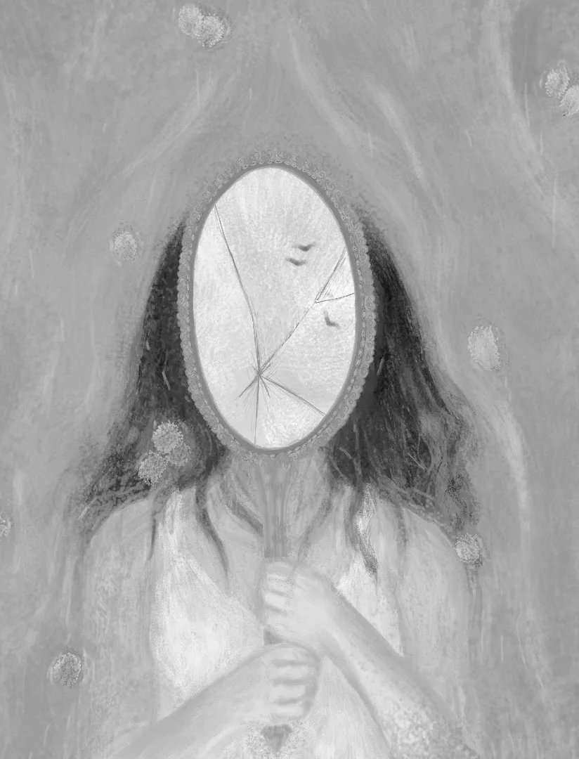
THE LOOKING GLASS SELF
A psychological concept that describes how a person’s self image is formed based on their perception of how others see them (Cooley, 1930)

Slide 36
HOW YOUR COACHES WORK
Committed Listening
Paraphrasing
Positive Presupposition
Reflective Feedback

Slide 37
Committed listening leads to eloquent paraphrasing followed by the presumption of positive intent that builds trust for reflective feedback.

Slide 38
Listen for…
What the person wants.
Emotion.
Passion
Possibility / potential
(Sparks, 2006)
COMMITTED LISTENING

Slide 39
Paraphrasing sends three messages:
I am listening.
I am interested / I care.
I understand you (or I’m trying to).
(Lipton & Wellman, 2001)
PARAPHRASING

Slide 40
TYPES OF PARAPHRASES
acknowledging
You’re thinking that…
So, you’re wondering if..
You’re frustrated because…
summarizing
You’re ready to move on to…
First you will… then…
On the one hand… on the other…
Shifting focus
So, a major goal for you is to…
One strategy you are considering is…
(Lipton & Wellman, 2001)

Slide 41
The embedded presuppositions in our language can be hurtful to others. By paying attention to the presuppositions that we use and choosing our words with care, we can more positively influence the thinking and feelings of others with whom we are communicating.
(Elgin, 2000)
POSITIVE PRESUPPOSITION

Slide 42
INSTEAD OF aSKING
Is this…?
Did you…?
Have you…?
Can you…?
Have you thought about…?
START WITH…
Knowing that…
What…?
When…?
How…?
Given that…?

Slide 43
Communicative, reflective, feedback:
Clarifies an idea or behavior under consideration.
Communicates concerns and offers suggestions toward improvement.
Consumes more time, requires thought and effort.
Is received as careful, respectful and honest.
(Perkins, 2002)
REFLECTIVE FEEDBACK

Slide 44
SCENARIO
You are Maya. You plan your lessons, follow every procedure, arrive on time, keep a calm classroom, and clearly care about your students. During your formal observation, though, your questioning stayed at a surface level (mostly yes/no or recall) and you often answered your own questions before students could think. Your post-observation conference is tomorrow. What will you write in your reflection, and what will you hear from your Field Supervisor?

Slide 45
THE CONVERSATION YOU WILL HAVE
1. Start with Heart.
2. Learn to look.
3. Make it safe.
4. Master your stories.
5. State your path.
6. Explore others’ paths.
7. Move to action.
(Patterson, Grenny, & McMillan, 2021)

Slide 46
Start with Heart.
Focus on your true intent.
Before engaging in this conversation, what do I truly want - for myself, the other person, and our relationship?
(Patterson, Grenny, & McMillan, 2021)

Slide 47
Learn to look.
Notice the signs of dialogue breakdown.
What verbal and nonverbal cues suggest that this conversation is breaking down? How can this be addressed?
(Patterson, Grenny, & McMillan, 2021)

Slide 48
Make it safe.
Foster mutual respect and purpose to encourage openness.
How can I create an environment where the other person feels respected, heard, and safe to express their perspective?
(Patterson, Grenny, & McMillan, 2021)

Slide 49
Master your stories.
Distinguish between facts and your interpretations while managing your emotional responses.
Is my reaction based on facts, or did I make assumptions about the other person’s intentions or behaviors?
(Patterson, Grenny, & McMillan, 2021)

Slide 50
State your path.
Express your viewpoint clearly and respectfully using facts, stories, feelings, and requests.
How can I clearly express my concerns using facts and emotions without blaming or escalating tensions?
(Patterson, Grenny, & McMillan, 2021)

Slide 51
Explore others’ paths.
Actively listen and invite others to share their perspective.
How can I invite the other person to share their perspective and ensure they feel genuinely heard?
(Patterson, Grenny, & McMillan, 2021)

Slide 52
Move to action.
Agree on clear next steps and accountability measures.
What concrete next steps can we agree on to ensure accountability and progress?
(Patterson, Grenny, & McMillan, 2021)

Slide 53
Start with Heart.
“The goal of this conversation is to support your continued growth as a teacher - especially in ways that help students explain their thinking and engage more deeply with the content.”

Slide 54
Learn to look.
“During today’s math lesson, students were asked questions like, ‘Is this numerator right?’ and ‘What’s the answer here?’ Many responded quickly, but several waited for confirmation or didn’t speak. A few questions were answered before students had time to respond.”

Slide 55
Make it safe.
“You’ve created a calm and structured space for learning. That consistency really helps students feel secure. This is a great foundation to build on as we look at how to deepen their thinking.”

Slide 56
Master your stories.
“It’s common for new teachers to focus on efficiency, especially in pacing. When questions go unanswered, it can feel uncomfortable or off-track. But often, that silence is where students are actively processing.”

Slide 57
State your path.
“The questioning pattern in this lesson leaned heavily on recall. That limited opportunities for students to explain their reasoning, compare strategies, or respond to one another’s ideas. Increasing wait time and adding open-ended prompts could extend their thinking.”

Slide 58
Explore others’ paths.
“What has been your approach so far when it comes to asking questions? Are there times you’ve felt unsure about how long to wait or how students might respond?”
Let Maya share her thinking. Prompt gently if needed: “How do you decide what kind of question to ask?” or “What’s been working well for you so far?”

Slide 59
Move to action.
“Let’s identify two places in tomorrow’s lesson where an open-ended question could replace a yes/no one - something like, ‘How do you know?’ or ‘Show me another way to solve that.’ Afterward, we’ll take a few minutes to reflect on how students responded.”

Slide 60

NEXT STEPS

Slide 61
READY TO BEGIN CLINICAL TEACHING?
1
Sign the Handbook & Code of Ethics Acknowledgment and complete district clearance.
PROGRAM CONTACT
Dr. Leslie Hancock
Education Department Chair
AAS, AAT, BAAS Director
Proposed WC EPP Chief Operating Officer
2
Complete the Supervision Schedule with your team by the end of Week 2.
3
Record hours daily, get weekly initials, and submit reflections and plans on time.
4
Prepare for every observation and bring your reflection to every conference.
lhancock@wc.edu
(817)598-8962
wc.edu/edbachelors
Completing the state-required exit survey is a requirement for completing the program.

Slide 62
References
Aguilar, E. (2013). The art of coaching: Effective strategies for school transformation. Jossey-Bass.
Burley-Allen, M. (1995). Listening, the forgotten skill. John Wiley & Sons.
Cooley, C.H. (1930). Sociological theory and social research. Scribner.
Costa, A. L., & Garmston, R. J. (2016). Cognitive coaching: Developing self-directed leaders and learners (3rd ed.). Rowman & Littlefield.
Council of Chief State School Officers (CCSSO). (2013). InTASC Model Core Teaching Standards and Learning Progressions for Teachers 1.0. Washington, DC: Author.
Elgin, S. (2000). The gentle art of verbal defense at work. Prentice Hall.
Fisher, D., & Frey, N. (2014). Better learning through structured teaching: A framework for the gradual release of responsibility (2nd ed.). ASCD.
Friend, M., & Cook, L. (2017). Interactions: Collaboration skills for school professionals (8th ed.). Pearson.
Knight, J. (2016). The impact cycle: What instructional coaches should do to foster powerful improvements in teaching. Corwin.
Lipton, L., & Wellman, B. (2018). Learning-focused supervision: Developing professional expertise in standards-driven systems (3rd ed.). MiraVia.
Lipton, L. & Wellman, B. (2001). Mentoring matters. Center for Cognitive Coaching.
Patterson, K., Grenny, J., & McMillan, R. (2021). Crucial conversations: Tools for talking when stakes are high (3rd edition). McGraw Hill.
Perkins, D. (2002). King Arthur’s round table: How collaborative conversations create smart organizations. Wiley.
Sparks, D. (2006). Leading for listening. Corwin.
Texas Administrative Code (TAC). Title 19, Part 7, Chapters 228, 229, 230, 231, and 247 (as in effect August 2026). Texas Education Agency.
Texas Education Agency. (2016). Texas Teacher Evaluation and Support System (T-TESS) Rubric. Retrieved from:

