Slide 1
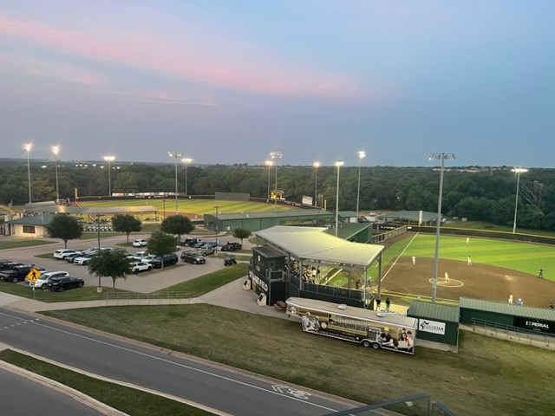


COYOTE ATHLETICS
STANDARD OF EXCELLENCE
PRESENTATION TO WC BOARD OF TRUSTEES, 11/10/22
ASST. ATHLETIC DIRECTOR JEFF LIGHTFOOT

Slide 2

THANK YOU FOR YOUR COMMITMENT TO OUR STUDENT ATHLETES
“You have five choices in life with regards to your success – you can be bad at what you do, you can be average, you can be good, you can be excellent or you can be elite at what you do. To be excellent or elite requires that level of commitment – you reap what you sow”
Nick Saban
Alabama Football
Thank you for choosing to be elite!

Slide 3
2021-22 year in review
200 Student-Athletes
SA’s in the classroom (average 15 hours per semester)
enrolled in more than 6,000 hours in 21-22
145 SA’s in Coyote Village & eating in the WC Café
200 SA’s utilizing our Academic Support Center & Staff
60+ SA’s are headed to universities – with the expectation to earn a degree
20+ of those SA’s entered the workforce (many through WC programs such as the Vet Tech Program)

Slide 4
COYOTE RODEO Head Coach Johnny Emmons
17 scholarships/ 72 athletes
Women’s Team - National Champs!
5 individual National Champions
5 currently sit #1 heading into this Year’s World Championships
23 AA degrees
12 headed to universities
17 entered the workforce

Slide 5
COYOTE BASEBALL Head Coach Jeff Lightfoot
20 scholarships/40 SA’s
39 wins
Ranked as high as #5 nationally
Regional qualifier/Quarterfinals
17 AA degrees
21 headed to universities
Received the NJCAA Academic Team of the Year award (Team GPA 3.0+)
Two current Coyotes in the MLB – 34 former players have played professional baseball

Slide 6
COYOTE SOFTBALL Head Coach Haylee Williams
20 scholarships/20 athletes
27 wins
Postseason berth/ 3rd place finish in regional
7 AA degrees
7 headed to universities
6 academic All-Americans
Received the NJCAA Academic Team of the Year award ( 3.0+ team GPA )

Slide 7
LADY COYOTE BASKETBALL Head Coach Bob McKinley
15 scholarships/15 SA’s
15 wins
Regional Qualifier/ Lost to #7 NMJC in regional
Ranked as high as #12 nationally
7 headed to universities
4 AA degrees
Received the NJCAA Academic Team of the Year award (Team GPA 3.0+)
Coach McKinley approaching career win 1,000!!

Slide 8
COYOTE BASKETBALL Head Coach Chris Lewis
15 Scholarships/ 15 SA’s
15 wins
5 headed to universities
4 AA degrees
Received the NJCAA Academic Team of the Year Award (Team GPA 3.0+)
OFF TO A HOT START THIS FALL (6-1)

Slide 9
COYOTE GOLF Head Coach Jesse Speirs
5 scholarships/8 SA’s
National Qualifier
1 team 1st place finish/ 1 second & 1 third
3 individual wins
Ranked as high as #15 nationally
Received the NJCAA Academic Team of the Year Award
Finished with the 4th highest team GPA in the nation

Slide 10
COYOTE TENNIS Head Coach Mitch Veccione
6 scholarships/8 SA’s
National Qualifier
2 headed to universities
Finished #8 in the nation
1 All-American
Received the NJCAA Academic Team of the Year Award (Team 3.0+ GPA)

Slide 11
COYOTE VOLLEYBALL Head Coach Kailee May
12 scholarships/ 17 SA’s
Conference Champs!
Regional Finals
21 Wins
1 headed to a universities
Coach May – Conf. Coach of the Year

Slide 12
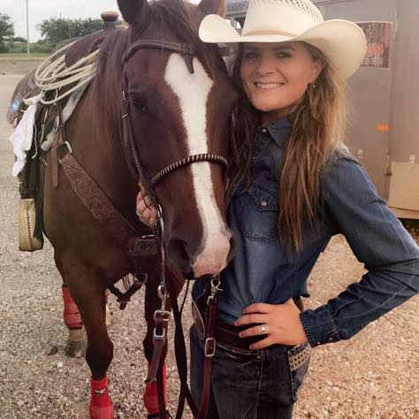
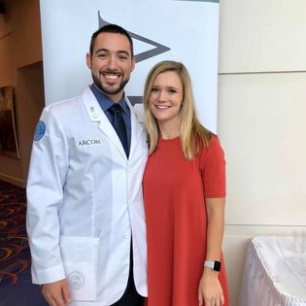
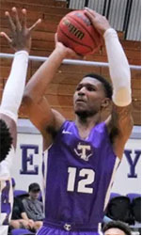
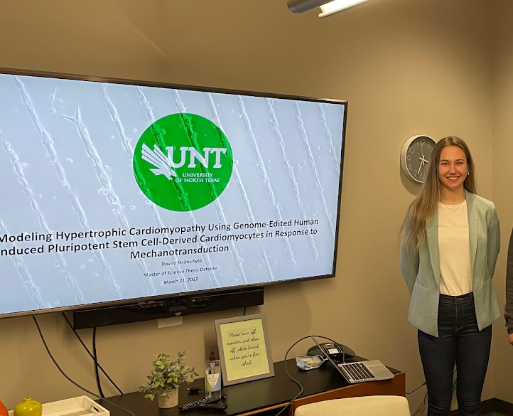
OUR COYOTES ARE LEADERS!
Hadley Butler Kibbe
WC Rodeo 16-18
BA Tarleton; MS Sul Ross
Dir Title III STEM, Sul Ross
Pres. ANRS & Rodeo Exes Assoc.
Asst. Rodeo Coach
Singer
Bobby Garner
WC Baseball 12-13
BS UT Dallas
DO Arkansas College of Medicine
Orthopedic Surgery Resident
Zach Naylor
WC Basketball 17-18
Tarleton Grad
Professional Basketball Player
Finland
Dovile Strimaityte
WC Basketball 17-18
BS/MS UNT Biomedical Engineering
Works in Bio Tech Boston

Slide 13
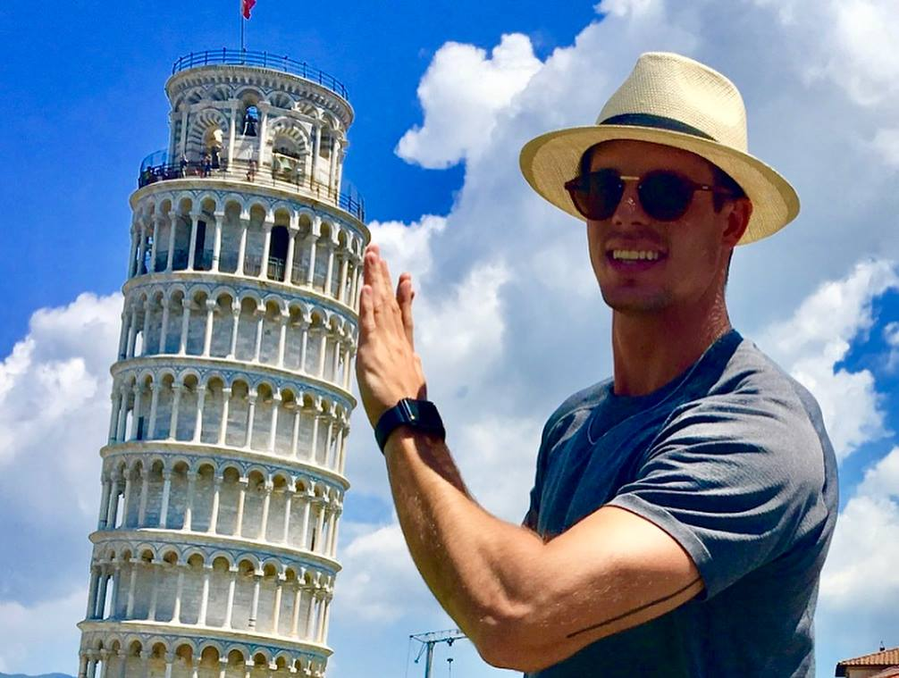
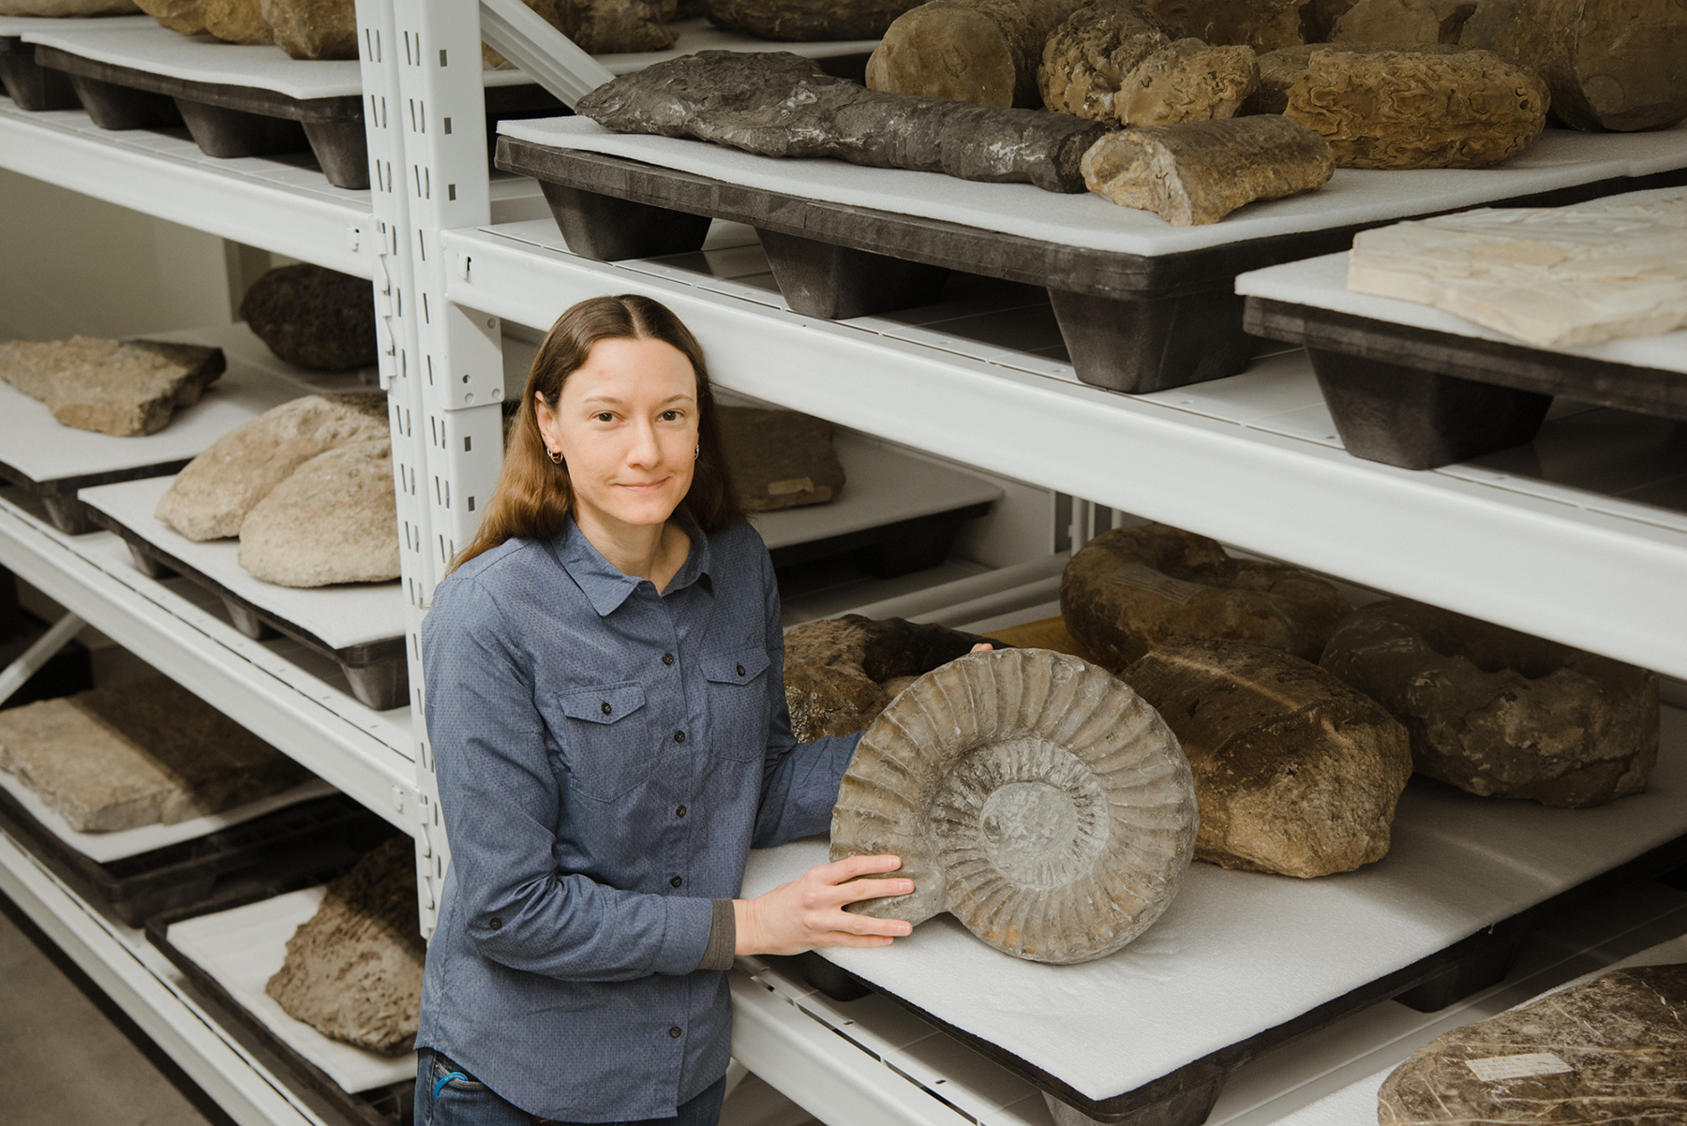
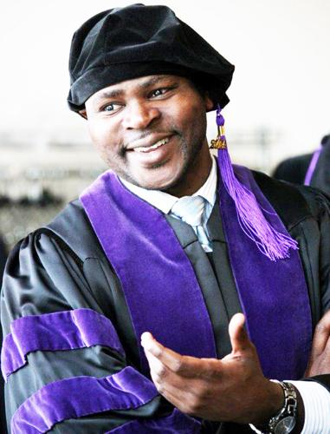
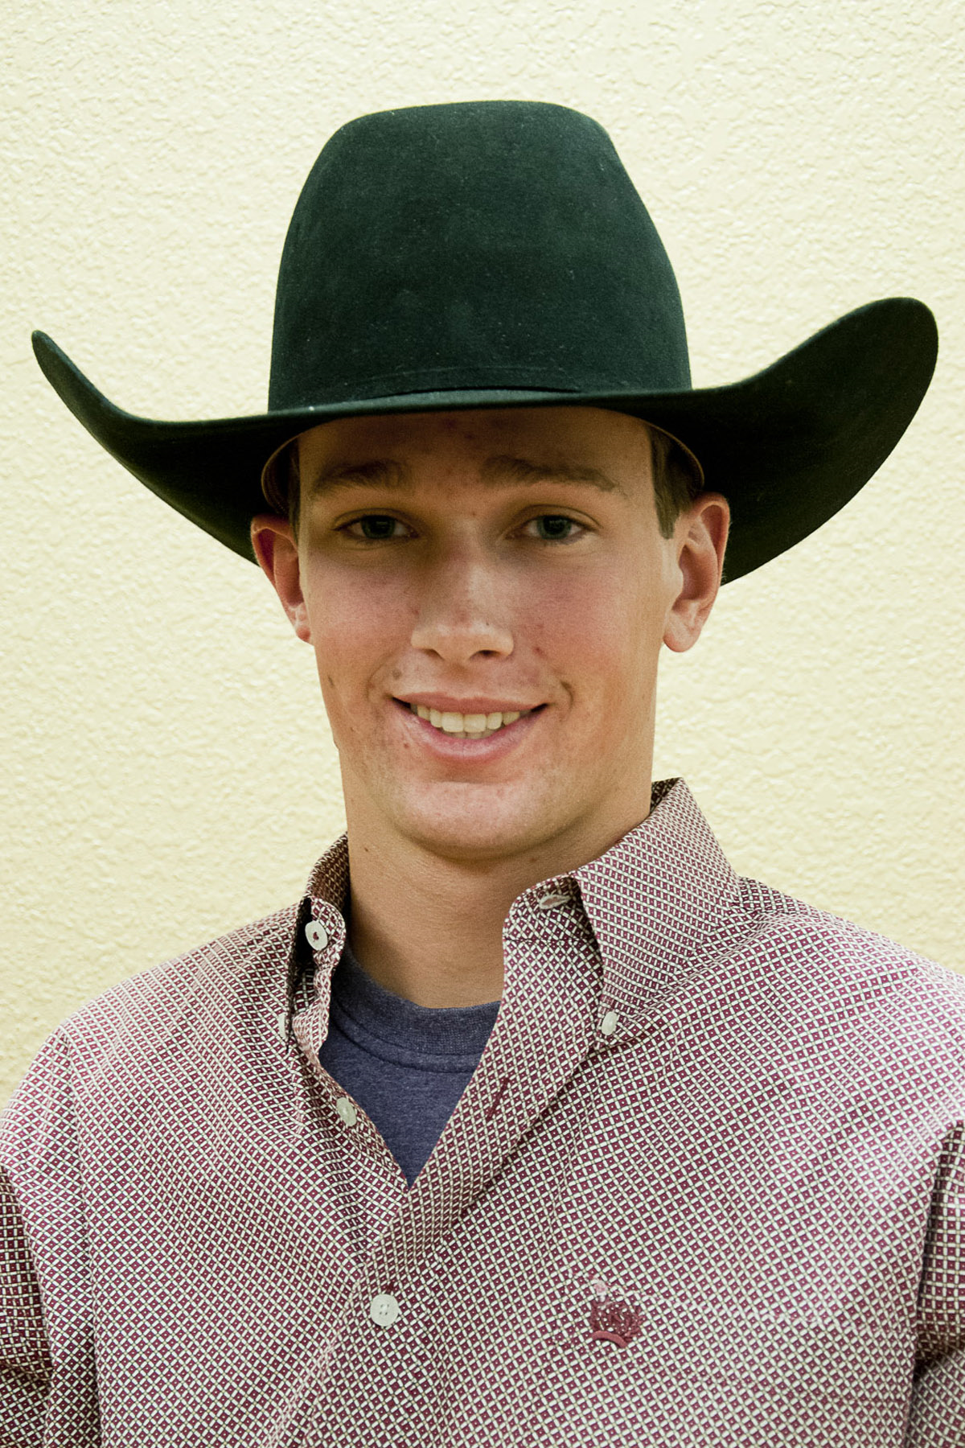
OUR COYOTES ARE INNOVATORS!
Skyler Wheeler
WC Baseball 12-13
BS TCU Geology
MS Rice Petroleum Geology
MBA SMU
Petroleum Geologist
Started his own Company, SPW Resources
Jessica Cundiff
WC Basketball
94-95
BS, MS Missouri St
MA Harvard
Paleontologist
Jared Parsonage
WC Rodeo 12-14
BS Tarleton Ag Business
Professional Bull Rider
Canadian Bull Riding Champion
National Finals Qualifier
Brice Nengsu
WC Basketball 04-05
BA Creighton
Crieghton Law School grad

Slide 14
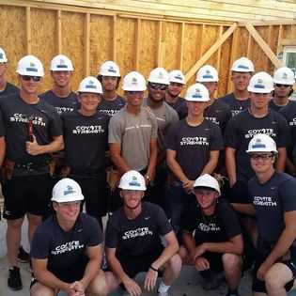
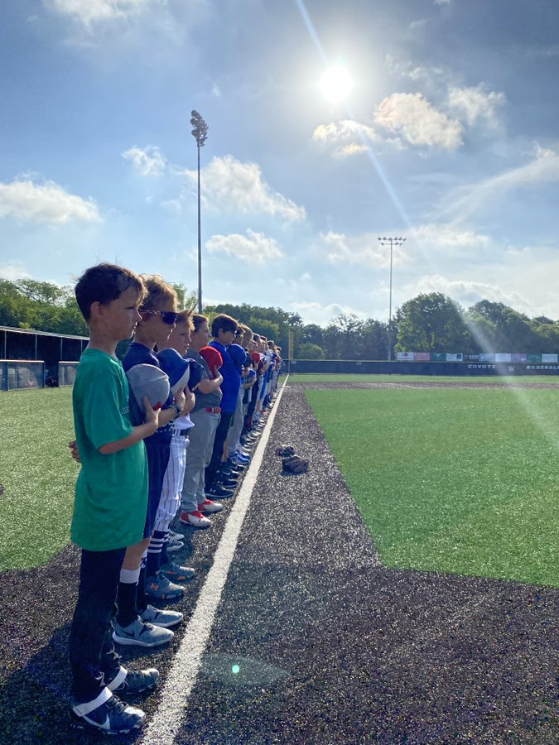
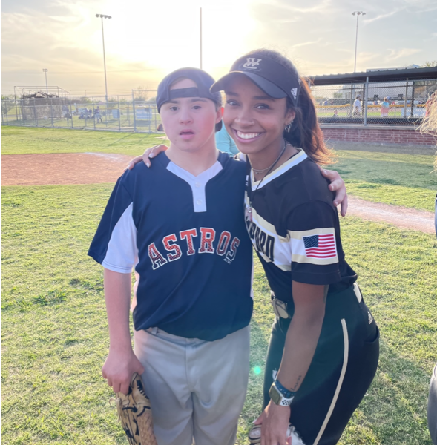
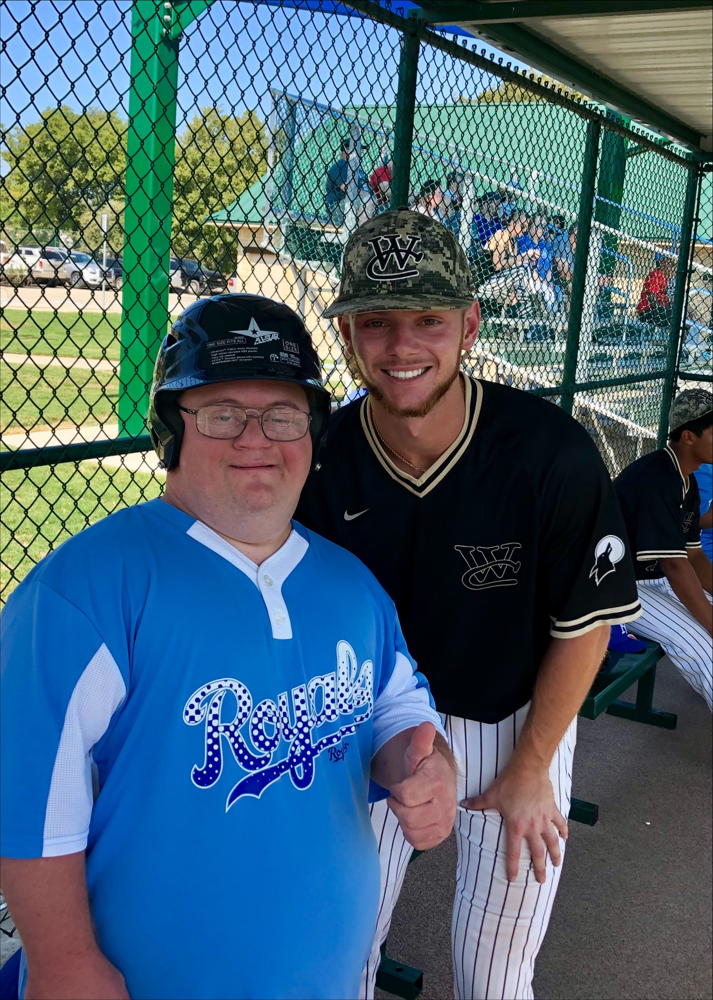
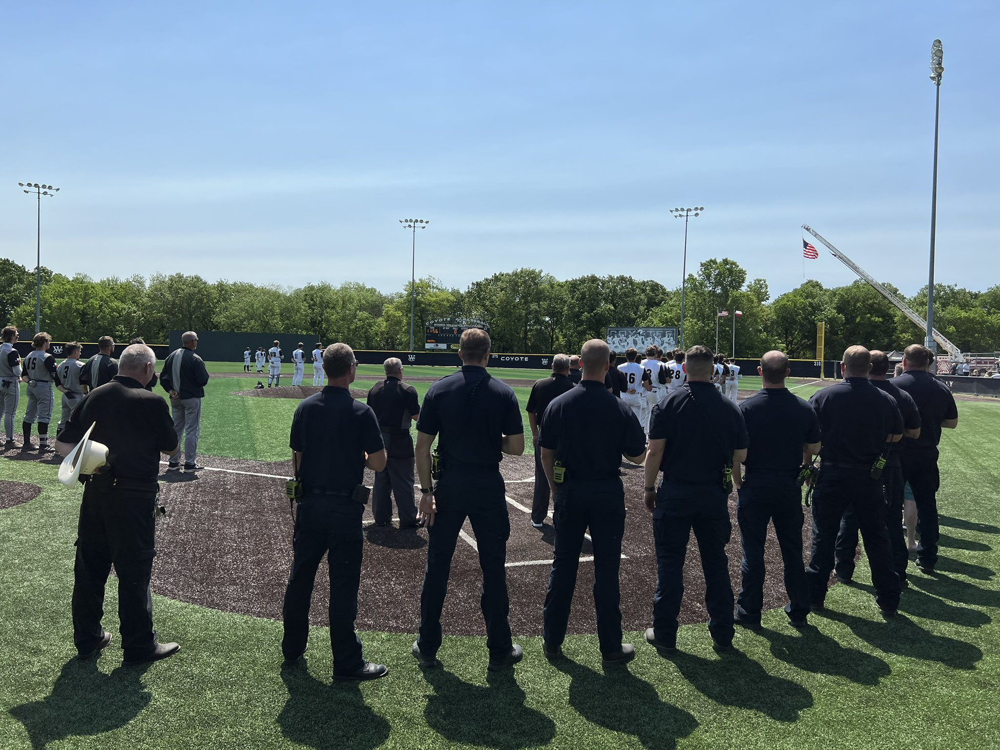
COYOTE OUTREACH
HABITAT FOR HUMANITY
KIDS CAMPS
CHALLENGER LEAGUE
FIRST RESPONDER DAY
WE ARE ALWAYS LOOKING
FOR OPPORTUNITIES
TO SERVE!
Miracle League

